Slide 1
Structured Hough Voting for Vision-based Highway Border Detection
Presenter: Zhiding Yu
Dept of Electrical and Computer Engineering
Carnegie Mellon University

Slide 2
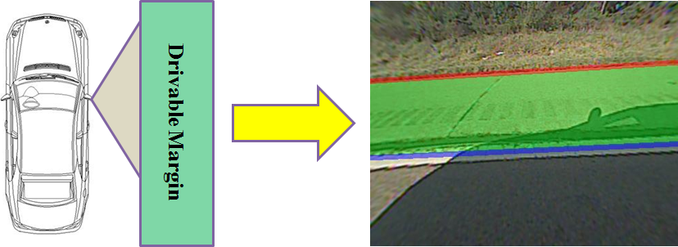
Problem Formulation
  Estimate the line hypotheses of border and the closest lane marker to return an estimated drivable margin.
  On the right-most lane, paved shoulder is expected to be detected. On the inner lanes, the detected margin also includes lanes on the right.

Slide 3
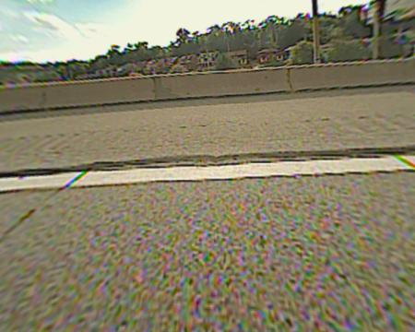
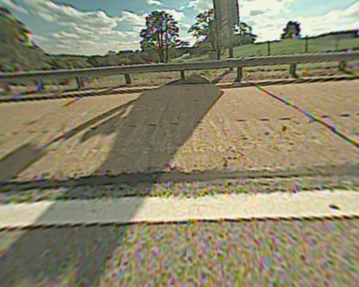
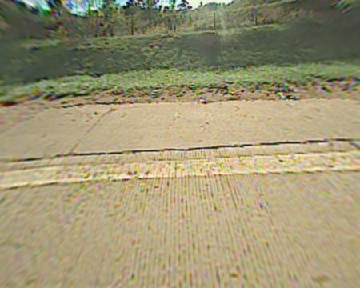
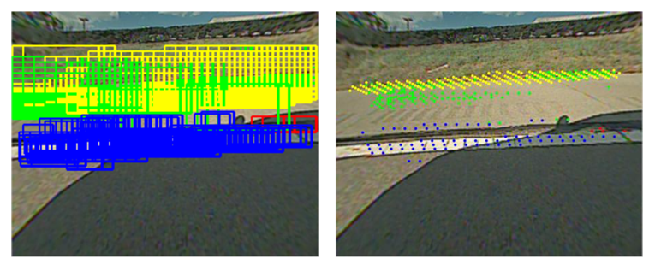
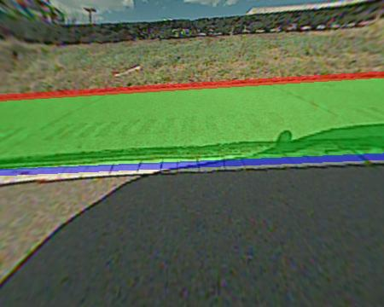
High-Level Idea: Learning based Method
Concrete Barrier
Guard Rail
Pavement Boundary
Concrete
Barrier
Guard Rail
Pavement Boundary
Lane Marker
Structured Hough Voting
Densely fired scanning windows
Returned voting points
Border / lane marker hypotheses

Slide 4
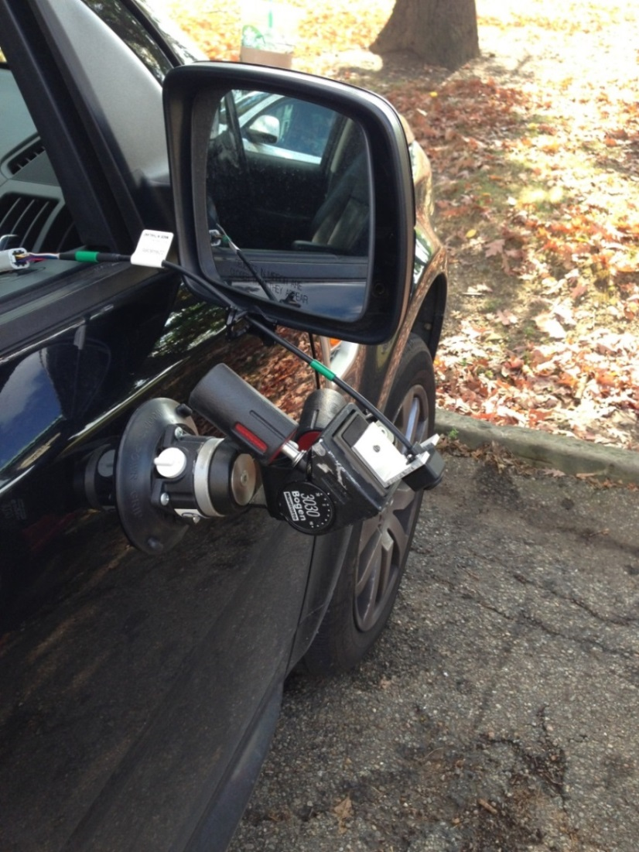
Dataset Collection
1592 training images:
Concrete Barrier (839 images)
Guard Rail (300 images)
Pavement Boundary (453 images)
2638 testing images:

Slide 5
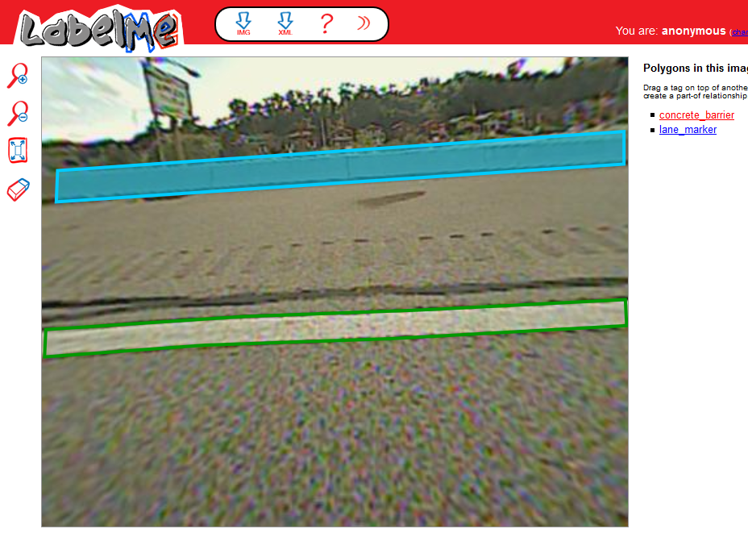
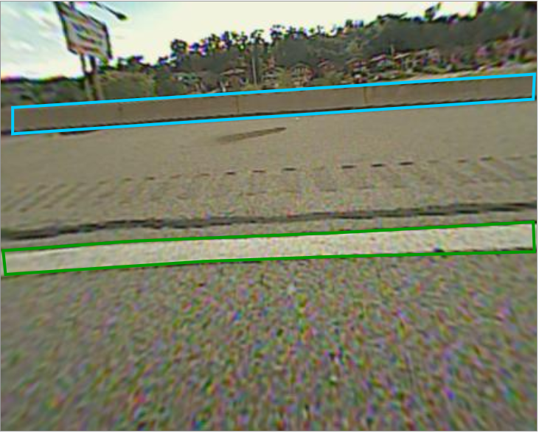








Training Patch Alignment
Positive Samples:
Negative Samples:
Notes:
For each sample patch, fix the width-height ratio to be 2
Center each patch with respect to y-coordinates of ground truth
1-3 positive samples from each image. Separate on x-coordinates to cover as much as possible.
Each positive sample is associated with 3 negative samples with the same size, randomly selected from background.

Slide 6
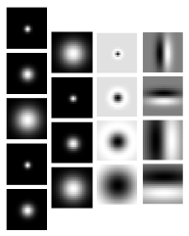
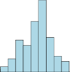
Feature Extraction
HOG
Filter Bank
Concatenated Filter Bank Feature
Concatenated HOG Feature
Patches that are discriminative to HOG
Patches that are discriminative to filter banks

Slide 7
Classification & Detection
Extract features from all training patches. (based on previous slide)
Perform Fisher discriminant analysis (FDA).
Train an RBF kernel SVM on training features returned by FDA.
Perform scanning window detection. (Deliberately triggering a lot of positive fired windows)
Return voting points of the fired windows.

Slide 8
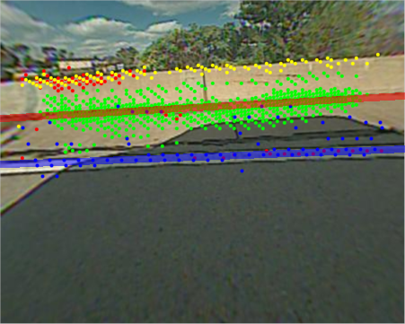
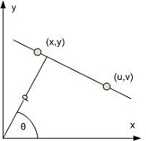

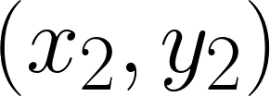



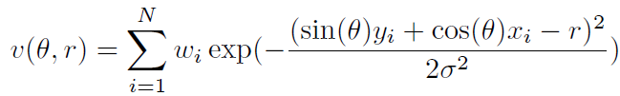
Frame-wise Independent Hough Voting

Slide 9
A Probabilistic Graphical Model Point of View
The hypothesis h_{i} = (r, θ) to be estimated in each frame can be regarded as a hidden variable with finite number of configurations (states).
The voting points in each frame can be regarded as certain observed variables x_{i}.
A joint distribution of H and X can be modeled by an undirected graphical model.
By literal meaning, a graphical model is a probabilistic model for which a graph expresses the conditional dependence structure between random variables. For undirected graphical model, factorizing the graph into cliques defines how the joint probability distribution can be factorized into a set of potential functions.
For example, the frame-wise independent Hough voting can also be explained by the following graphical model, where the conditional dependencies between each h_{i} and x_{i} are modeled as Hough voting scoring and a larger score indicates more likely state.
h₁
h₂
…
h_{N}
x₁
x₂
x_{N}

Slide 10
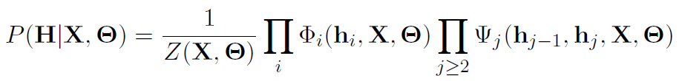
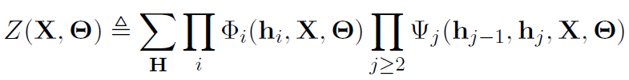

Modeling Inter-Frame Info with CRF
A Conditional Random Field (CRF) discriminatively defines a joint posterior probability which can be factorized into set of potentials.
The potentials are functions of h_{i} and x_{i}. They are modeled in such a way that a larger value generally indicates a preferred (more likely) state of h_{i}.
Inference: Find the best hypothesis configuration H* that maximizes the probability:
Unary Potential
Pairwise Potential
h₁
h₂
…
h_{N}
x₁
x₂
x_{N}

Slide 11
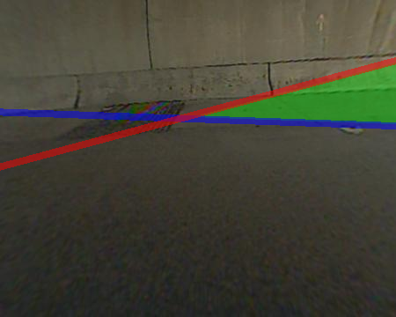
Structured Hough Voting: Motivation
Issues applying conventional CRF on our problem
Issue 1: The inter-frame smoothness may not always hold true since borders and lane markers may suddenly “jump” due to changing, merging and exits of lanes.
Issue 2: Failures of border/lane marker detectors may return very few or even false scanning window voting points.
Issue 3: Conventional CRF does not consider the intra-
frame geometric constraints between border and
lane marker.
Proposed improvements
Besides scanning window voting points, introduce gradient voting points.
Multiple candidate hypotheses generation (Proposals with diversity).
A coupled CRF model between border and lane marker hypotheses.

Slide 12
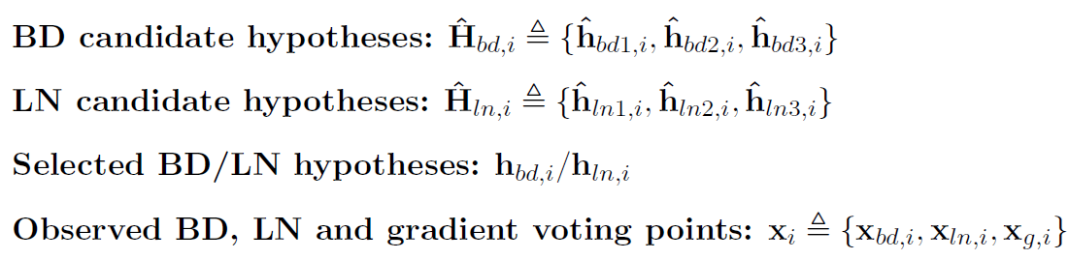
Structured Hough Voting: Notation

Slide 13





















Structured Hough Voting: Model
Mode Selection Potential
Candidate Hypotheses Generation Unit
• • •
Coupled Structure Potential
• • •

Slide 14
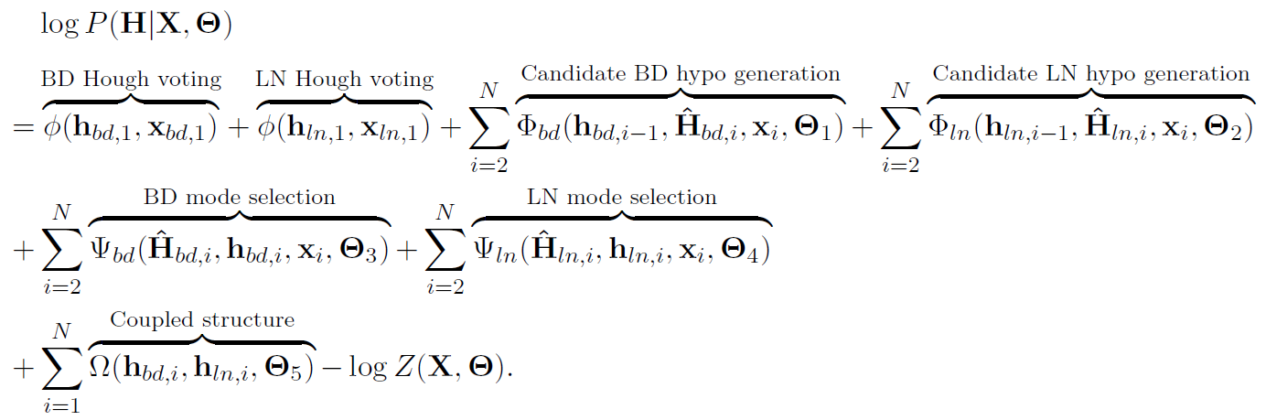
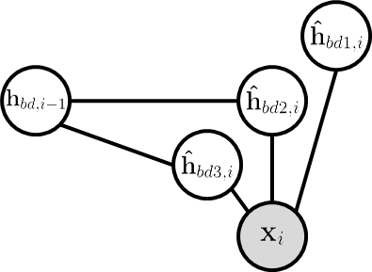
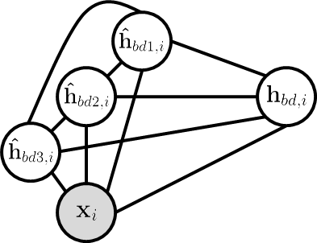

Structured Hough Voting: Model
Hypotheses
Generation Unit
Mode Selection
Potential
Coupled Structure
Potential

Slide 15
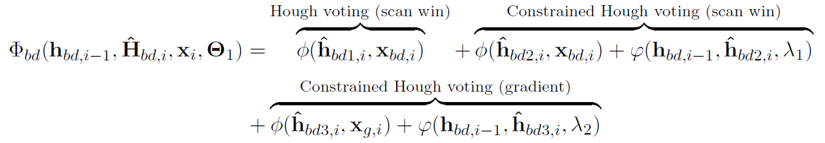
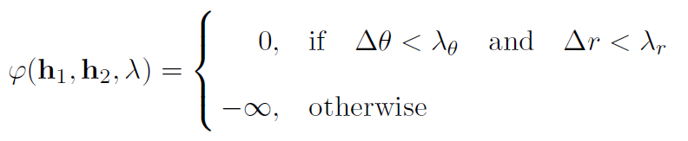
Candidate Hypotheses Generation Unit

Slide 16
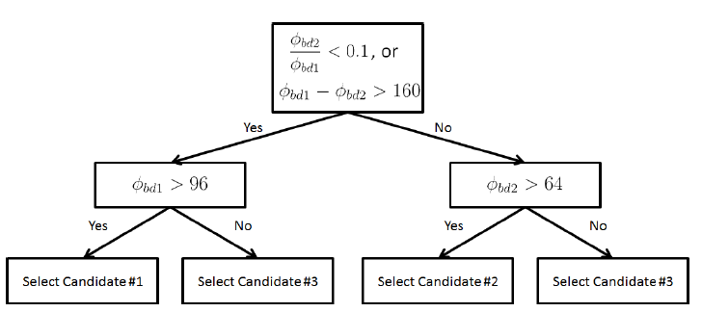
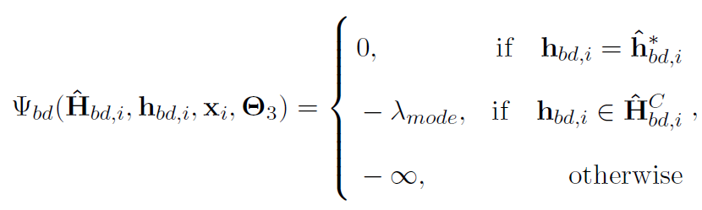
Mode Selection Potential
Use decision tree to guide the mode selection.
The mode selection basically forces the output to be one of the candidate hypotheses, but allows discrepancy with the decision tree prediction with a penalty.

Slide 17
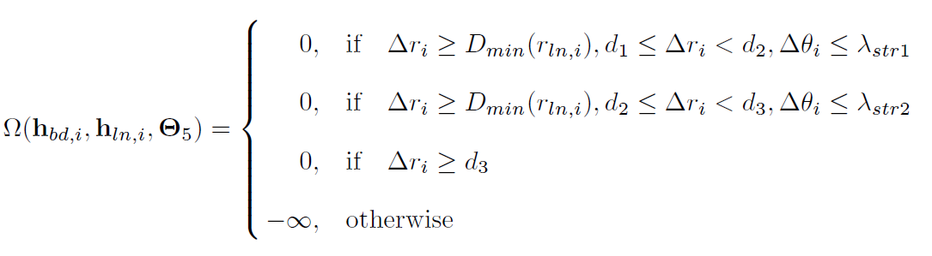



Coupled Structure Potential
The coupled structure potential captures two most important relations between a border hypothesis and a lane hypothesis
Parallelism: The assumption gets stronger as border and lane marker gets closer.
Distance: The border hypothesis is always above the lane marker hypothesis.

Slide 18

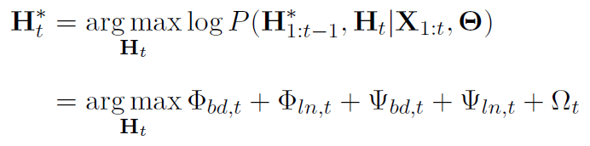
Inference
Ideally, we want a complete inference on all previous frames at each time t.
In reality, we reuse the previous inference result on 1 : t-1 frames, and only infer the current frame t in an online updating style:

Slide 19
Inference
Inference procedure at t = 1:
1. Perform Hough voting for both border and lane marking
2. Perturb hypotheses if geometric relationship violated (optional)
Inference procedure at t > 1:
1. Generate the 3 candidate hypotheses for both border and lane marking
Candidate-1: Unconstrained Hough voting.
Candidate-2: Constrained Hough voting on scanning window voting points.
Canddiate-3: Constrained Hough voting on gradient voting points.
2. Use decision tree to select the best candidate.
3. Perturb border candidate hypotheses if geometric relationship violated (optional)
4. Re-select the best candidate

Slide 20
Experiments

Slide 21
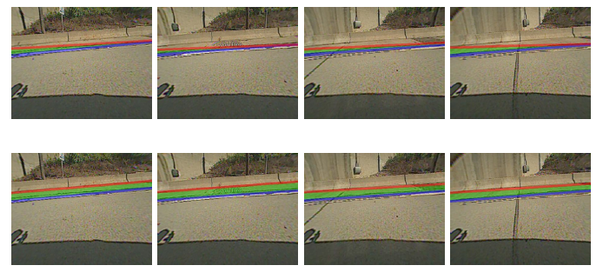
Experiment: Coupled Structure Constraint
Without Coupled Structure
With Coupled Structure

Slide 22
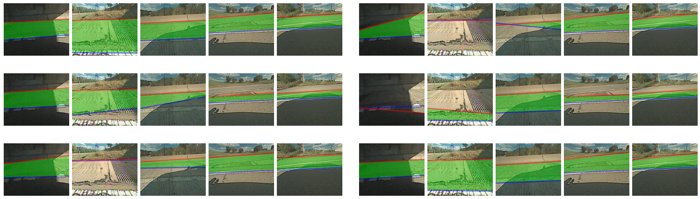
Experiment: Qualitative Results
Ground Truth
Baseline1
Baseline2
Baseline3
Kalman Filter
Proposed Method
Baseline1: Unconstrained Hough voting with scanning window voting points.
Baseline2: Constrained Hough voting with scanning window voting points.
Baseline3: Adding gradient tracking on Baseline2.

Slide 23
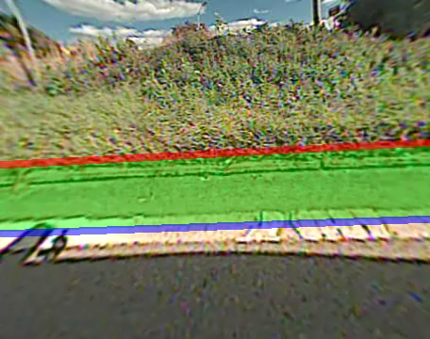
Experiment: Qualitative Results

Slide 24
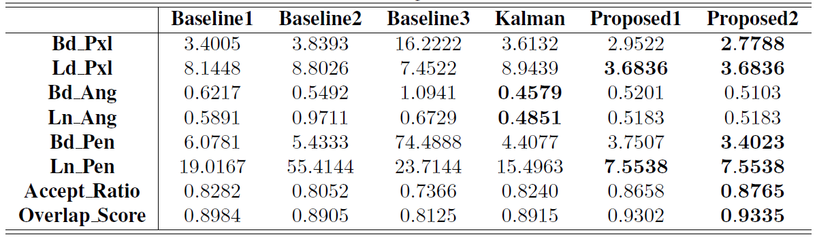
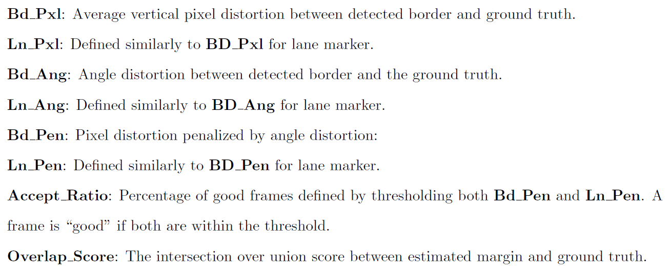
Experiment: Quantitative Results

Slide 25
Concluding Remarks
Addressed highway border and shoulder detection by exploring structured information and formulating the tracking-and-detection problem as a structured Hough voting model.
The structured Hough voting model is a conditional random field.
Proposed fast real-time feature extraction and online inference.
Achieved robust performance under challenging scenarios and low quality inputs from production camera.

Slide 26
Thank You!

